Slide 1

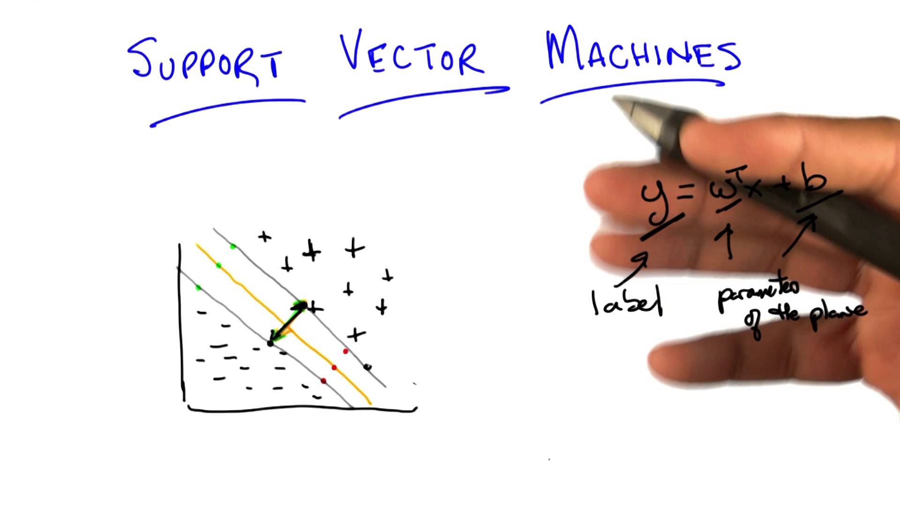
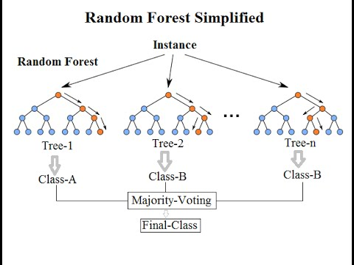
Maximizing bank’s marketing campaign profitability
Through machine learning

Slide 2
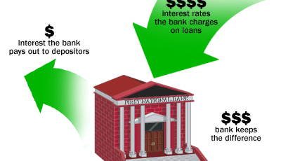
Problem background
Portuguese retail bank marketing long-term deposit offer to existing customers
Long-term deposits
Fixed investment term, usually 1 to 5 years
Safe investments
Very appealing to conservative, low-risk investors
Marketing channel used – Telemarketing

Slide 3
DATA at a glance
Data Source
Publicly available on UCI website
CSV format
Data from external sources has been used during cost-benefit analysis
Data
Data collected is from May 2008 to Nov 2010
21 attributes and 41188 observations
20 independent variables – client data, call data, socio-economic factors and campaign data

Slide 4
GOAL
Prediction about customers that are most likely to accept term deposit offer
Metric – Campaign profitability
End goal is to Maximize campaign profitability
Evaluate multiple machine learning algorithms and shortlist the one providing highest Profitability

Slide 5
DATA WRANGLING
Missing value treatment
6 variables with missing values
‘Unknown’ data converted to numpy NaN
Based on analysis done during EDA phase,
Default, loan, housing variables have been dropped
VARIABLE | % MISSING VALUES
job | 0.8
marital | 0.2
education | 4.2
default | 20.9
housing | 2.4
loan | 2.4
ALL OTHER VARIABLES | 0

Slide 6
EXPLORATORY DATA ANALYSIS
Features
Non-linearity with age variable
Chi-square
Data Normalization
Multi-collinearity among macroeconomic factors
Principal Component Analysis
Eigen values and scree plot

Slide 7
EXPLORATORY DATA ANALYSIS Important Features
Dependent Variable (y)
11.2% of them have accepted the offer
88.8% of them have rejected it
Highly imbalanced dataset
Independent variable – ‘Job’
Retired category
Average age – 62yrs
Highest conversion rates
Promising category for our campaign
Student category
No consistent source of income
Most likely to look for avenues that can grow their savings without having inherent risks

Slide 8
EXPLORATORY DATA ANALYSIS Important Features
Independent variable - ‘Age’
Young age - more aggressive with respect risk and returns. Tend to invest more in stocks and less in safe avenues like deposits
As they get older this reverses – study by Dale Kintlez
Observed non-linear conversion rates with Age
45% aged over 60 yrs reacted positively to the offer
Young adults contradicted observations made in the study
Chi-square results confirmed a presence of significant difference in response with Age
Middle aged, pre-retirement and adult categories with similar conversion rates are grouped into ‘Working adult’ category for further analysis

Slide 9
EXPLORATORY DATA ANALYSIS Important Features
Months of the year
Portuguese tax year runs concurrently with the calendar year - 1 January to 31 December
Individuals hold liquid cash until year-end in anticipation of unexpected expenditures over the course of that year
While locking funds in low-return investments such as term deposits in initial months itself might not be a good decision, year-end could be a good time to invest in them in order maximize tax benefits
Data ranges from May 2008 to Nov 2010, thus reducing the possibility of random occurrences to a good extent.

Slide 10
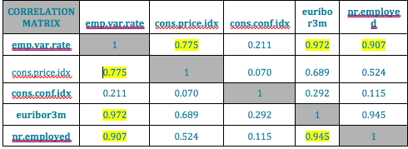
EXPLORATORY DATA ANALYSIS Important Features
Macro Economic factors, Multi-collinearity & PCA
High correlation among employee variable rate, euribor3m, nr.employed and cons.price.idx
PCA has been incorporated on the dataset to overcome this issue
Data has been normalized to bring all continuous values onto a common scale and reduce biases
Scree plot shows the fraction of variance explained by each PC and helps with identifying maximum number of components required to represent all variables considered for PCA

Slide 11
EXPLORATORY DATA ANALYSIS Important Features
Scree Plot observations:
Top 3 PCs cater to 97% of variance and hence these have been considered to replace all the macroeconomic factors
These PCs have been merged with the variables remaining after performing EDA, to arrive at our final dataset.
Variables in final dataset:
Age category, type of Job, Marital status
Education, Month, Day of week
Number of calls made, dependent variable
PCA1, PCA2, PCA3

Slide 12
Machine learning Models
Logistic Regression
Performance on original data
Data rebalancing
Regularization
Model Evaluation
Random Forest Classifier
Regularization
Model Evaluation
Support Vector Machine
Regularization
Model Evaluation

Slide 13
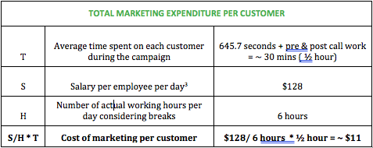
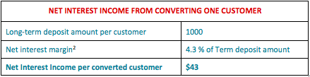
Evaluation Metrics
Profitability
Cost-Benefit Analysis
Profitability= $43*(True Positives) - $11*(True Positives + False Positives)
Advantages of Profitability
Best performance measure for this business need
Evaluating direct financial impact of model on campaign
Unbiased evaluation inspite of having imbalanced data unlike regular metrics such as precision, accuracy and F1 scores
ROC AUC
Advantages of ROC AUC
General metric
Deals well with situations where data is imbalanced like in our business case

Slide 14
BASELINE PERFORMANCE
Conversion rate for this campaign - 11.2%
Out of the total 41188 customers contacted,
4613 accepted offer
36575 rejected offer
Profitability = $43(Total converts)-$11(Total customers contacted)
= $43(4613)-$11(41188)
= $ 198,359 - $ 453,068
= (- $ 254,709)
Overall, this campaign made a loss of $254,709
Goal is not only to obtain profits but also to develop a model that can maximize it

Slide 15
Logistic Regression ORIGINAL Imbalanced data
Threshold at which profitability is the highest is: 0.21
Regularization Parameter C : 100
Maximum achievable profitability with the model is: $ 10,159
ROC AUC: 0.7746

Slide 16
Logistic Regression RESAMPLED DATA
 | Upsampled Data | Downsampled Data
Final Regularization parameters | C = 100 | C = 100
Threshold | 0.67 | 0.63
ROC AUC | 0.7783 | 0.7792
Profitability | $ 10,157 | $ 10,114
Profitability at varying thresholds

Slide 17
RANDOM FOREST CLASSIFIER
Threshold at which profitability is the highest is: 0.26
Regularization Parameters
min_samples_leaf = 5
min_samples_split = 10
n_estimators = 50
Maximum achievable profitability with the model is: $ 11,359
ROC AUC: 0.7955

Slide 18
Support vector machine
Threshold at which profitability is the highest is 0.1
Regularization Parameters
Kernel= RBF
C = 0.1
gamma = auto
Maximum achievable profitability with the model is: $ 8,536
ROC AUC: 0.7095

Slide 19
conclusion
 | Profitability | ROC AUC
Logistic Regression | $10,159 | 0.7746
Random Forest Classifier | $11,359 | 0.7955
Support Vector Machines | $8,536 | 0.7095
Random Forest Classifier is the best out of the three models evaluated
Provided an increase in profitability by 104.5 % over baseline model
Maximum Campaign profitability of $11,359 with this RFC

Slide 20
Its not over….

Slide 21
Future study
From the analysis done during this study, few variables had potential to help with other problematic areas faced by managers such as
Resource allocation & planning
Campaign variable can be analyzed in detail to arrive at a probable cut-off for the number of calls that could be made to a customer before making the efforts redundant. This could help cut down campaign costs and improve the overall efficiency of the team by helping them direct their efforts towards most probable customers
When economy is flourishing, more and more individuals are willing to invest. This requires a need for hiring additional employees to fulfill those temporary needs which could be a good input for campaign managers during resource allocation step
The same could be achieved from an in-depth analysis of peak months of the year when customers are most likely to accept term-deposits if offered during that time frame

Slide 22
THANK YOU Any questions?

